Slide 1
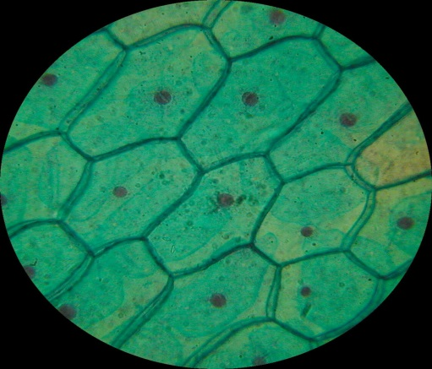
Introduction to Microscopy
Lesson Objectives:
Identify the parts of a light microscope
Correctly use a light microscope to look at plant and animal cells and draw accurate observations
Safely prepare slides of plant and animal cells, describing the procedure
Starter – LO1:
Why do we use microscopes?
Can you name the parts of a light microscope?
How do we correctly use a light microscope?
Review:
Be prepared to share your ideas

Slide 2
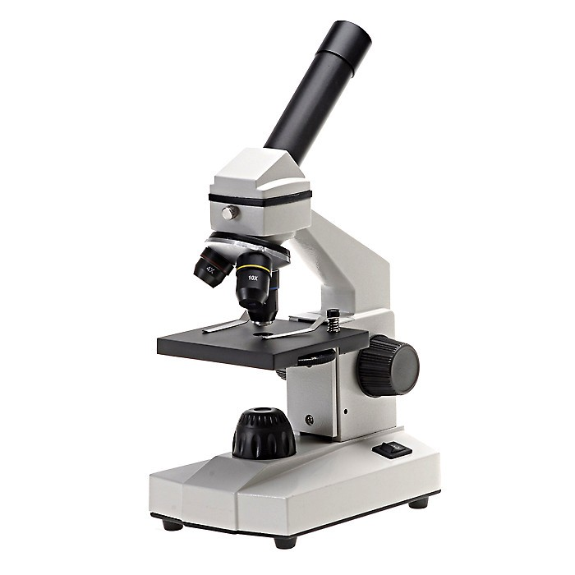
LO: Identify the parts of a light microscope
Can you name any parts?
What are these parts used for?
How do we use a microscope?
Review:
Be prepared to share your ideas
Notes:
See what they already know

Slide 3
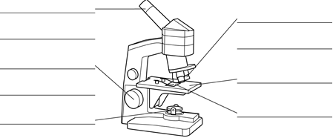
LO: Identify the parts of a light microscope
Engage
Elicit
Explore
Explain
Elaborate
Eyepiece lens
Well done – a microscope will allow us to look at the fibres really closely
Objective lens
Course adjustment
Wheel
Fine adjustment
Wheel
Stage
Light
Glass slide
Eyepiece lens, coarse adjustment wheel, fine adjustment wheel, objective lenses, glass slide, stage, light
Review:
Self assess
4

Slide 4

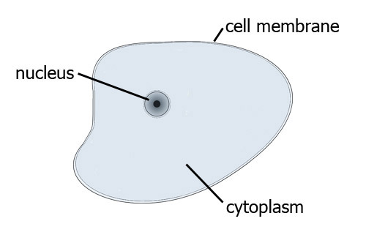
LO: Correctly use a light microscope to look at plant and animal cells and draw accurate observations
Cell diagrams…
Cells under a microscope

Slide 5
LO: Correctly use a light microscope to look at plant and animal cells and draw accurate observations
Task
Set up and use the microscopes
Correctly view prepared slides of plant and animal cells
Draw and label your observations
Review:
Be prepared to share your ideas

Slide 6
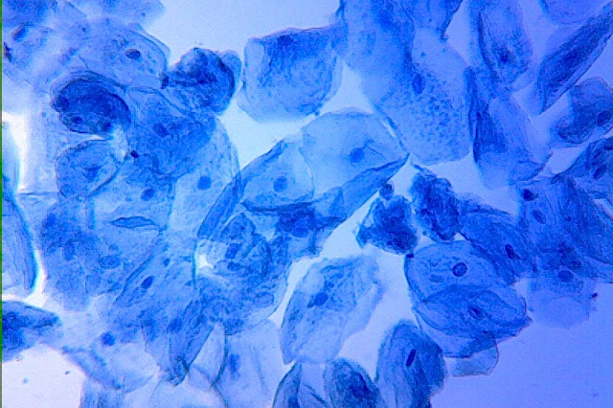
Where in your body will you find this?

Slide 7
LO: Safely prepare slides of plant and animal cells, describing the procedure
Preparing a cheek cell slide:
Take a swab from the inside of your cheek by gently rubbing and twisting the cotton wool swab
Rub this onto the middle of the slide
Dispose of the cotton wool swab in some disinfectant
Add a drop of methylene blue. This is a stain that will highlight the parts of the cell
Gently place a cover slip on top of the sample, so that it covers the stain but does not trap any air inside
View your sample under the microscope, starting at the lowest magnification
Demo and carry out practical
Notes:
Add a drop of iodine solution. This is a stain that will highlight the parts of the cell
Gently place a cover slip on top of the onion, so that it covers the specimen but does not trap any air inside
View your slide under the microscope, starting at the lowest magnification

Slide 8
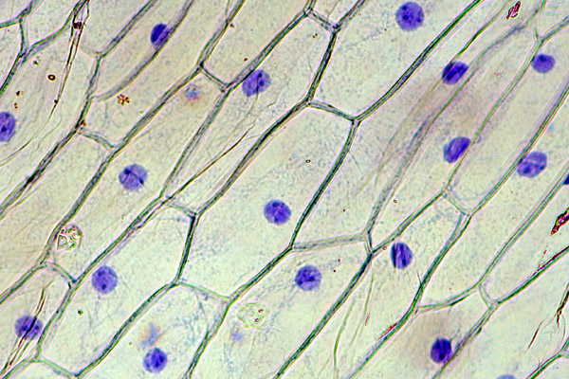
What is this?!

